Slide 1
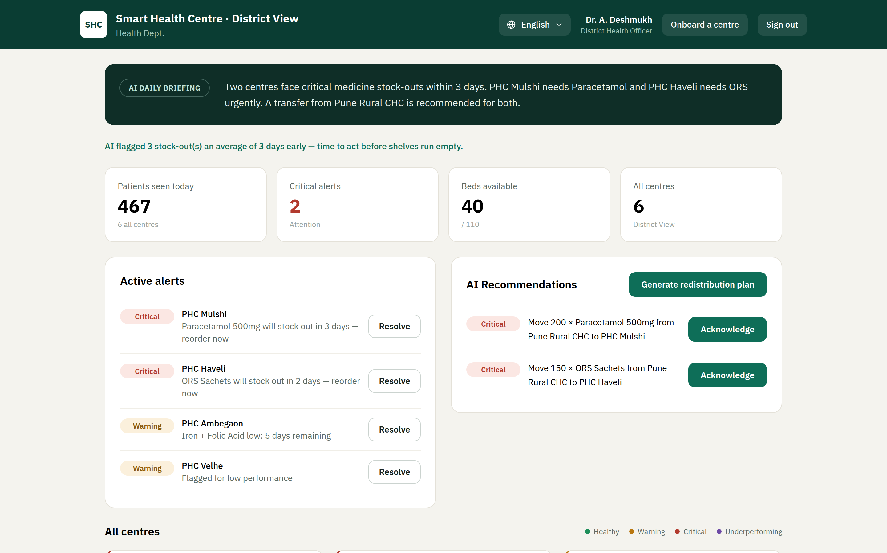
Smart Health
AI-Driven Health Center & Supply Chain Management · Team ai-rangers
Medicines run out before anyone knows
THE PROBLEM
▸ 30+ rural centres, on paper — a district officer runs them via registers and phone calls; a stock-out shows up only when a patient is turned away.
▸ No real-time picture — of stock, staff, beds or tests across the district.
OUR SOLUTION — SMART HEALTH
▸ A live district command centre — + a 60-second daily-report app for staff, with multi-language support.
▸ Warns days before a centre runs dry — and tells the officer exactly what to do.
Live on Google Cloud · smart-health-20737125641.asia-south1.run.app
1 / 3

Slide 2
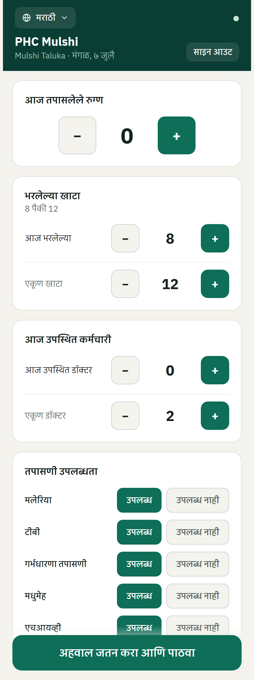
Smart Health
Key Features & Innovation
Built for the last mile — and hard to cheat
▸ Predicts & prevents stock-outs — flags a shortage days early and auto-suggests moving medicine from a surplus centre to one about to run dry.
▸ Report any way — tap, photograph a paper invoice, speak it, or text by SMS from a basic phone — no smartphone or internet needed.
▸ Anti-corruption by design — rejects impossible entries, signs every report to a person, and lets citizens confirm from a QR poster at the centre.
▸ Early outbreak warning — spots a spike in fever / diarrhoea medicine across neighbouring centres before it spreads.
Real algorithms make the decisions; the AI only explains them, in the officer's language.
Live on Google Cloud · smart-health-20737125641.asia-south1.run.app
2 / 3

Slide 3
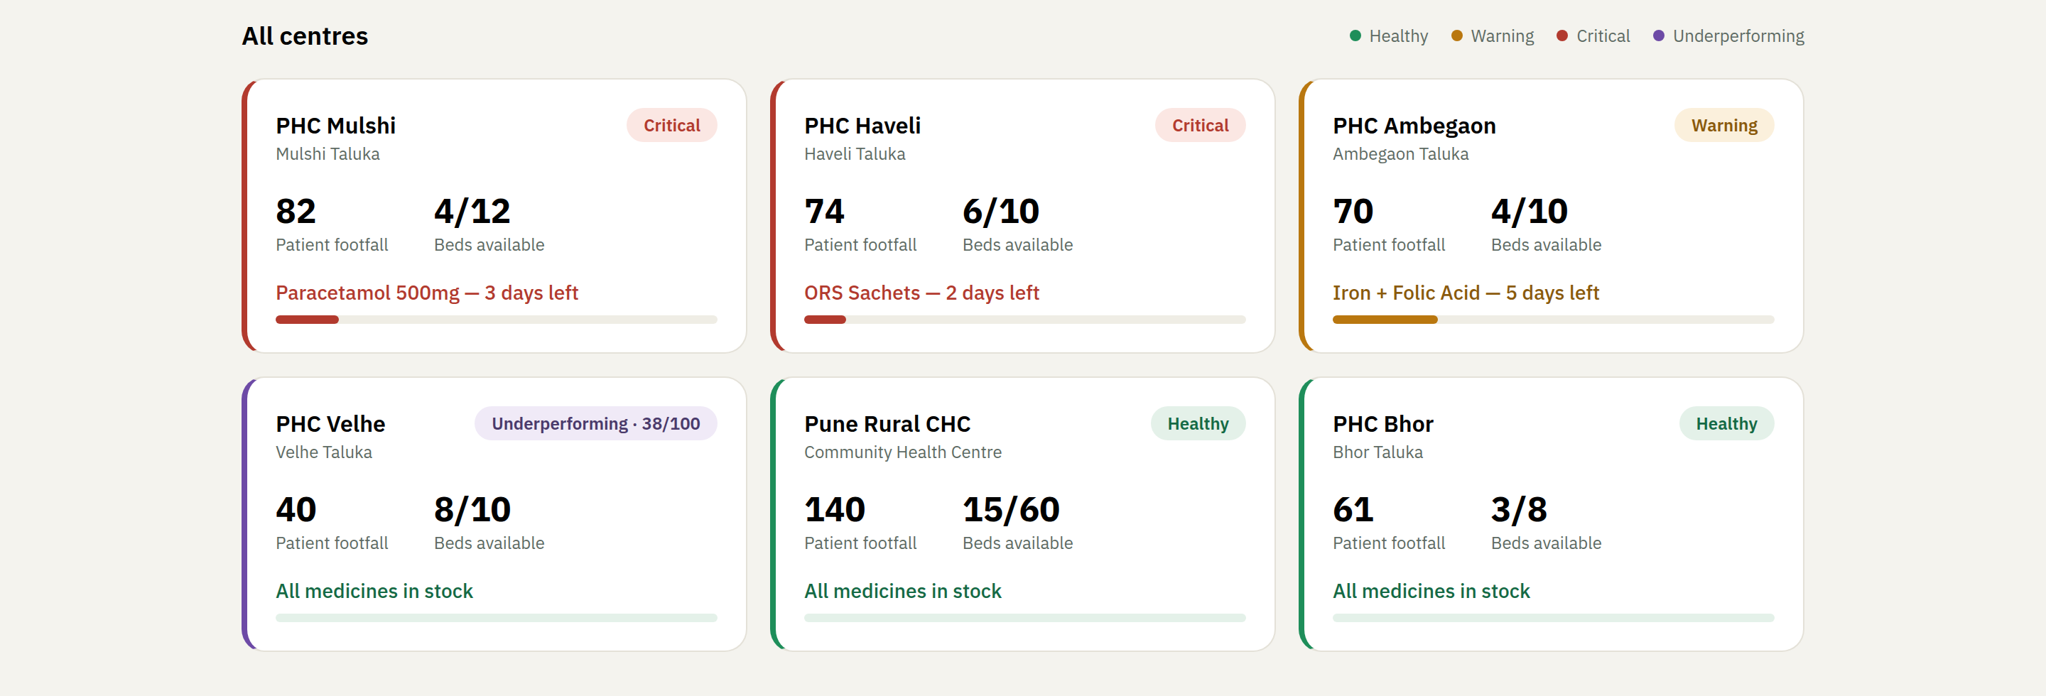
Smart Health
Impact & Scalability
Fewer stock-outs, less diversion, money saved
up to 6 days
1,800+
100%
of early warning before a stock-out
patient-treatments safeguarded in one demo district
of reports signed, logged & auditable
READY TO SCALE — HOW GOVERNMENT CAN HELP
▸ Already live on Google Cloud — deployable to a real district in weeks.
▸ A pilot in your constituency's PHCs — one block of centres, 90 days.
▸ Integrate, don't replace — syncs with ABDM, e-Aushadhi and HMIS; SMS/WhatsApp for the last mile.
The ask: give us one block of PHCs for a 90-day pilot — we'll bring the numbers.
Live on Google Cloud · smart-health-20737125641.asia-south1.run.app
3 / 3

